Slide 1
How do we generate structures with Seq2Seq?
Wenhu Chen

Slide 2
Seq2Seq

Slide 3
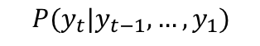
Seq2Seq
Formulate generation in the Markov recursion.
$$P(y_{t}|y_{t−1},…, y_{1})$$

Slide 4
Seq2Seq
Formulate generation in the Markov recursion.
It is well suited to machine translation, summarization, etc
$$P(y_{t}|y_{t−1},…, y_{1})$$

Slide 5
Seq2Seq
Formulate generation in the Markov recursion.
It is well suited to machine translation, summarization, etc.
$$P(y_{t}|y_{t−1},…, y_{1})$$
Can it handle constrained sequence, or structured sequence?

Slide 6
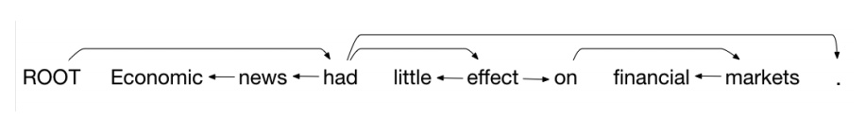
Seq2Seq for Structures
Graph

Slide 7
Seq2Seq for Structures
Graph
Lambda Calculus

Slide 8
Seq2Seq for Structures
Graph
Lambda Calculus
Code

Slide 9
Linearization
Transition-based LSTM (Dependency Graph)
Sequence-to-Tree LSTM (Logic Form)
Abstract Syntactic Tree LSTM (General-Purpose Code)
1. ﻿Transition-Based Dependency Parsing with Stack Long Short-Term Memory
2. Language to Logical Form with Neural Attention
3. A Syntactic Neural Model for General-Purpose Code Generation

Slide 10
Shift-Reduce Linearization
Process a sentence word by word from a buffer
You can temporarily place store words on a stack
As you process you can either:
Shift: Move a word from the buffer to the stack
Left: The top of the stack is the child of the buffer’s next word
Right: The buffer’s next word is the child of the top of the stack

Slide 11
Shift-Reduce Linearization
Initially the stack has root, the buffer has the sentence’s words, and there are no edges
At the end, the buffer must be empty

Slide 12
Example
Original Dependency Graph

Slide 13
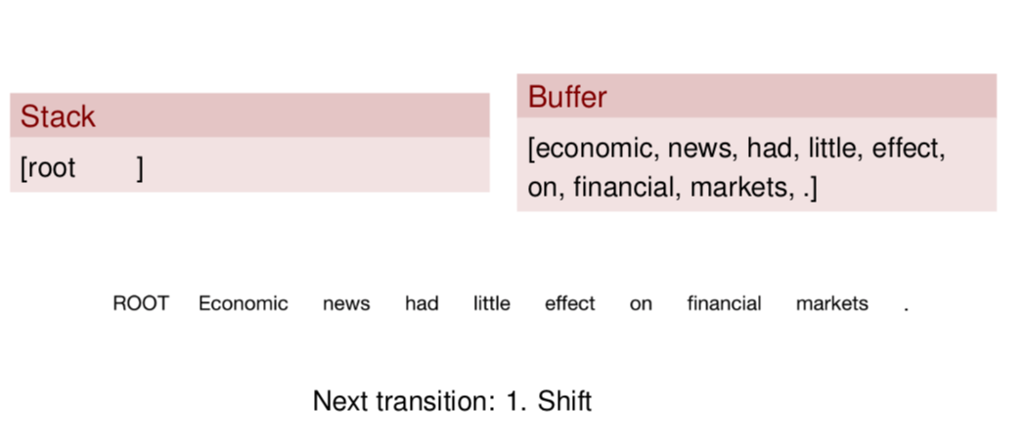
Example

Slide 14
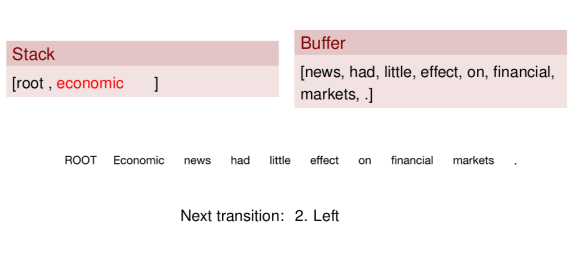
Example

Slide 15
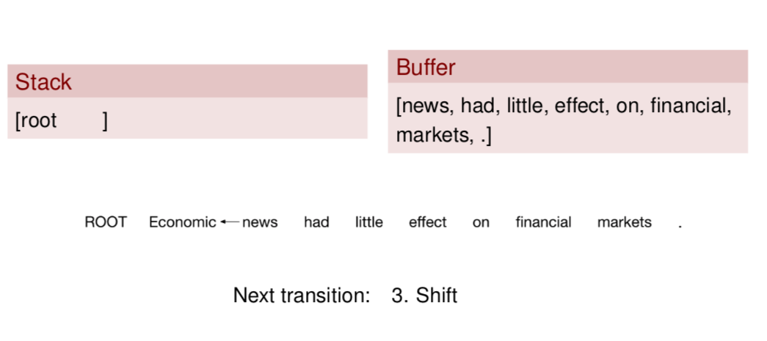
Example

Slide 16
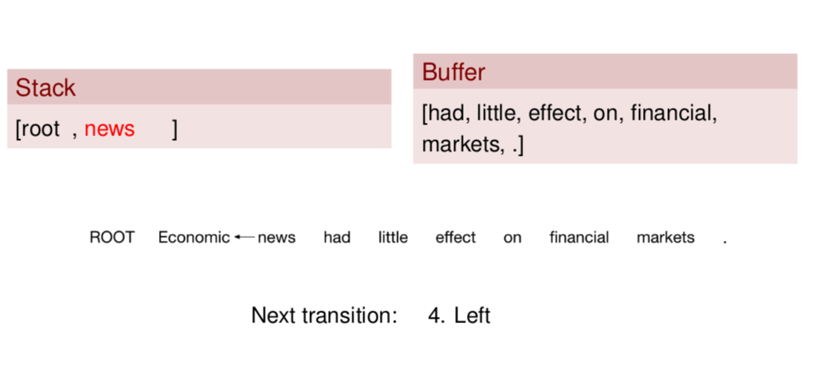
Example

Slide 17
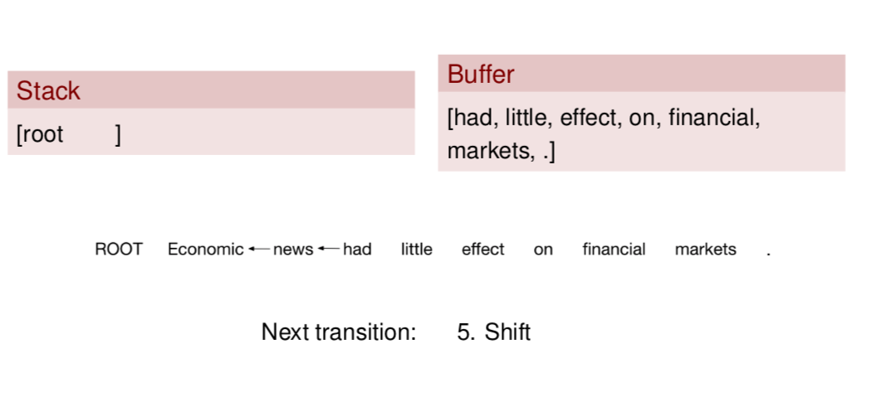
Example

Slide 18
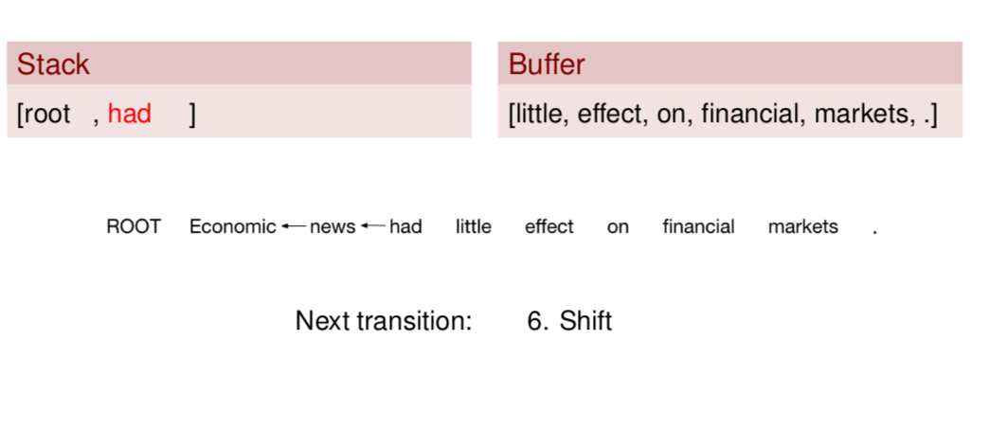
Example

Slide 19
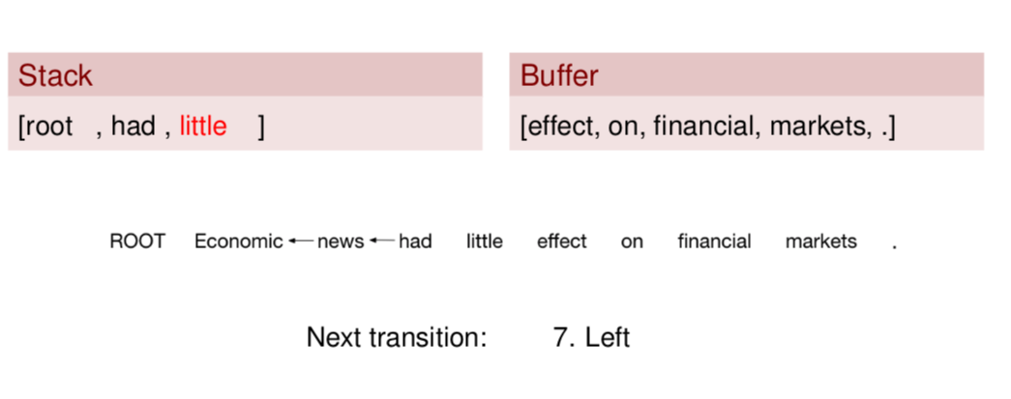
Example

Slide 20
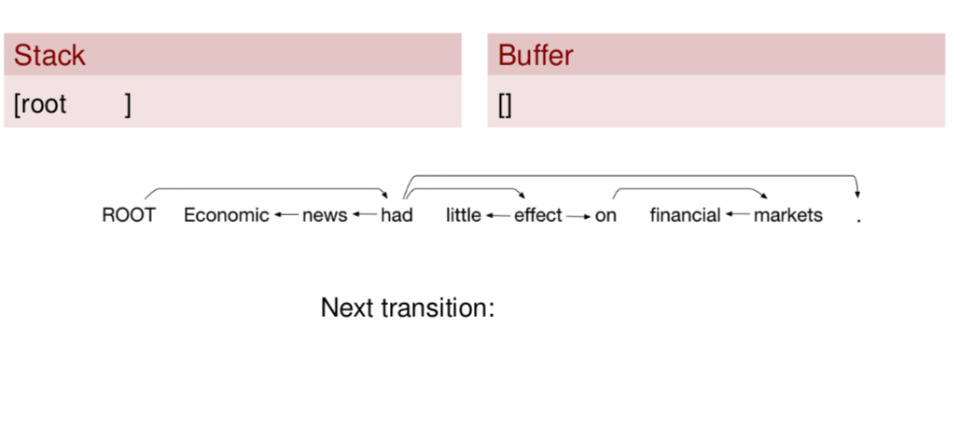
Example

Slide 21
Transition-based LSTM
Sentence
Stack
Buffer
Action
Action
Action
Action

Slide 22
Transition-based LSTM
Sentence
Stack
Action
Buffer
LSTM
Action
Action
Action
Action

Slide 23
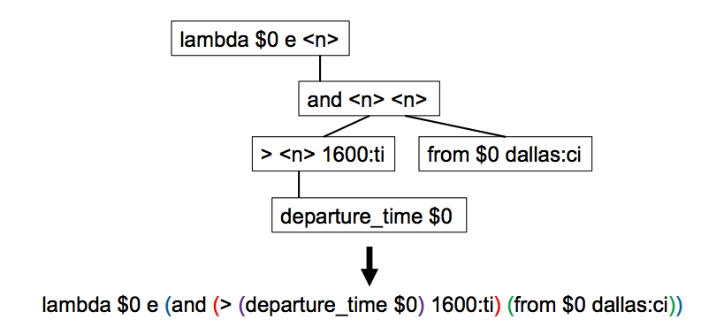
Seq-to-Tree Linearization
Seq2Seq model ignores the hierarchical structure.
Use “()” to linearize logical form

Slide 24
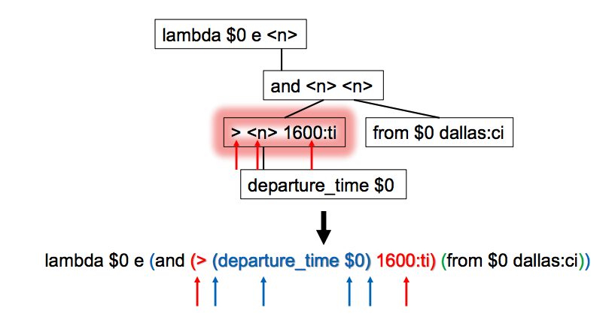
Seq-to-Tree Linearization
Seq2Seq model ignores the hierarchical structure.
More long-distance dependency during decoding

Slide 25
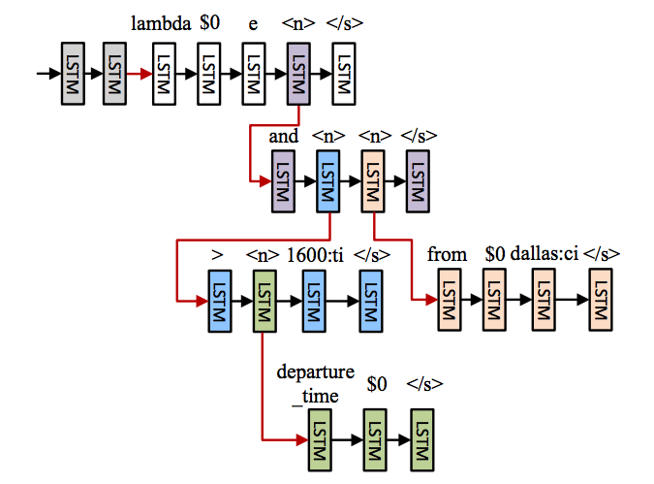
Seq-to-Tree Linearization
Subtrees in decoder

Slide 26
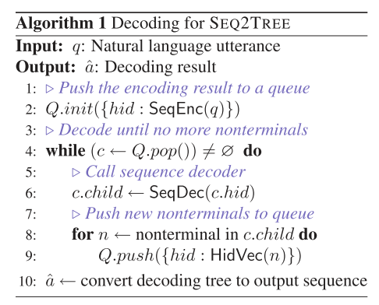
Seq-to-Tree Linearization
Subtrees in decoder

Slide 27
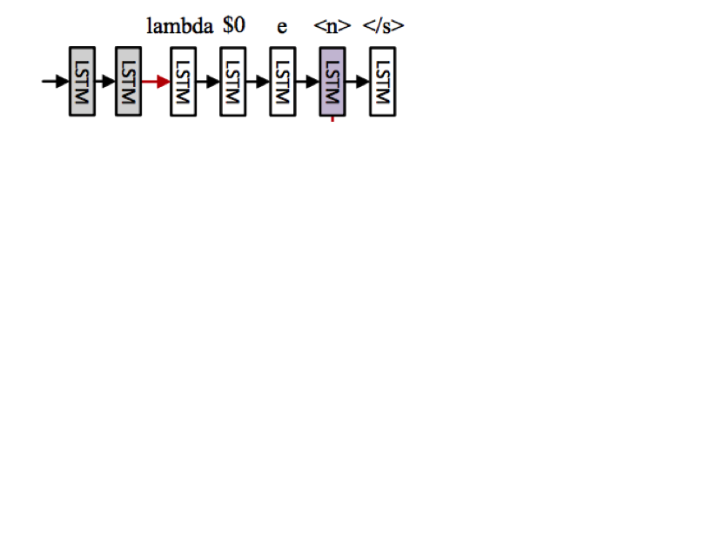
Seq-to-Tree Linearization

Slide 28
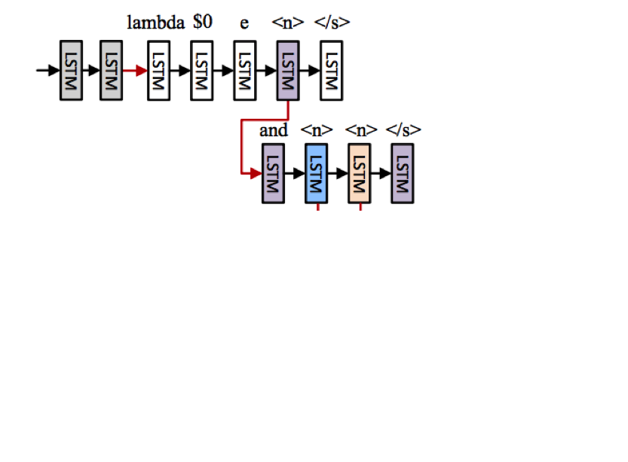
Seq-to-Tree Linearization

Slide 29
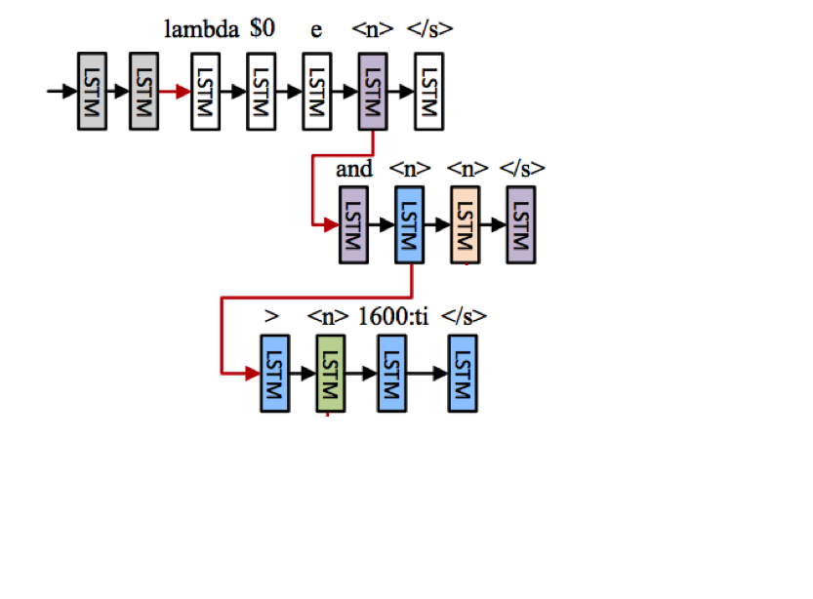
Seq-to-Tree Linearization

Slide 30
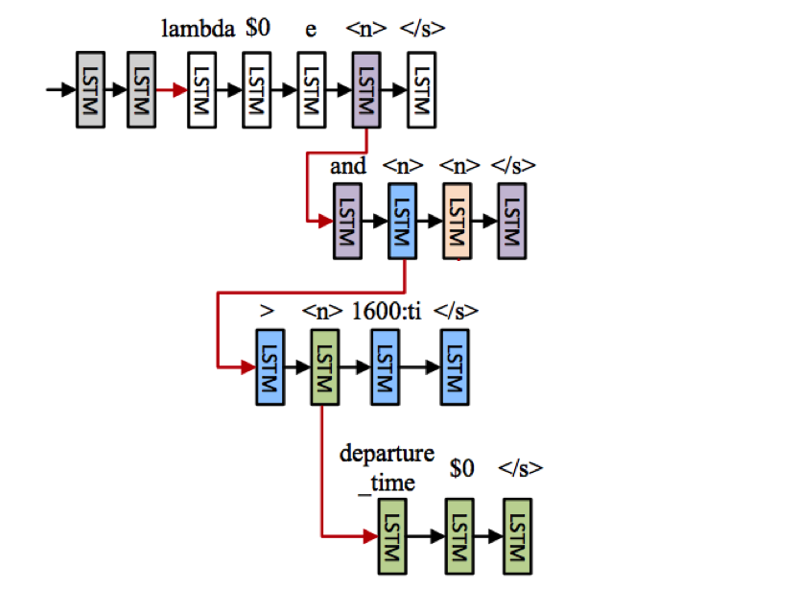
Seq-to-Tree Linearization

Slide 31
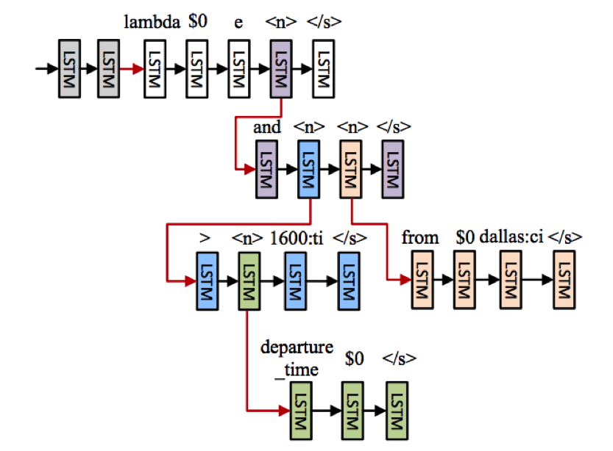
Seq-to-Tree Linearization

Slide 32
AST Linearization (Grammar)
Root->Expr
Expr->expr[value]
expr[value]->Call
Call->expr[func], *expr[args], keyword *[kwargs]
Expr[func]->sorted/print/…
Expr[args]->expr, [expr, expr], … , [expr, … expr]
Keyword*[keywords]->keyword

Slide 33
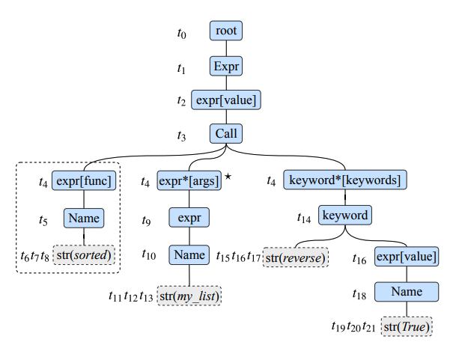
AST Linearization
sorted(my_list, reverse=True)

Slide 34
AST Linearization
sorted(my_list, reverse=True)

Slide 35
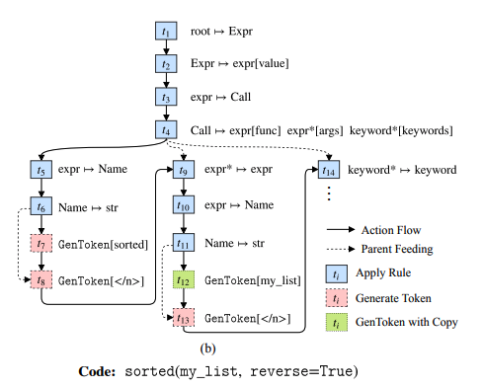
AST Linearization

Slide 36
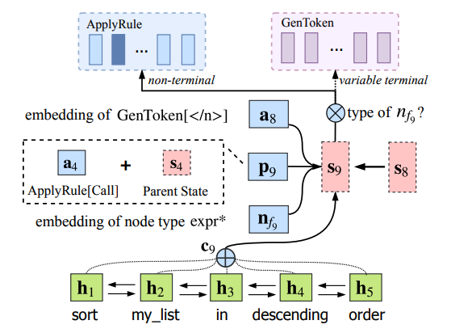
AST Linearization

